Slide 1


SHAPING HEALTHCARE’S FUTURE
THROUGH ADVOCACY
NAHU CAPITOL CONFERENCE 2018

Slide 2
AGENDA - LEGISLATIVE UPDATE
Capitol Hill
Omnibus tax bill
ESC Coalition
Description of the coalition partnership
Executive Order
Updates:
Market Stabilizers to Reduce Cost and Improve Individual and Employer Market Risk Pool
Association Health Plans (AHPs)
Short-term Limited Duration Policies (STLDIs)
Legislative outlook and priorities
Taxes and Other Repeals
Medicare
Regulatory outlook and priorities

Slide 3

Capitol Hill

Slide 4
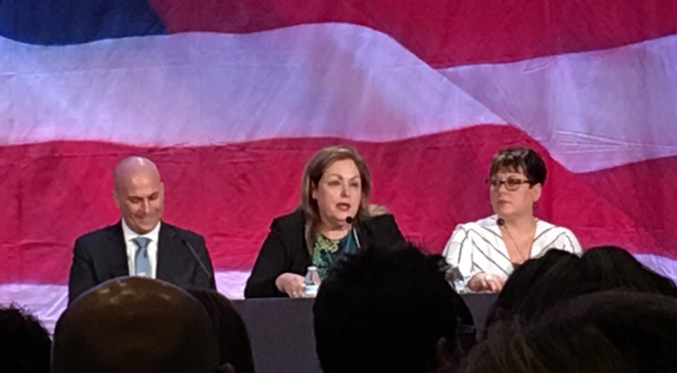
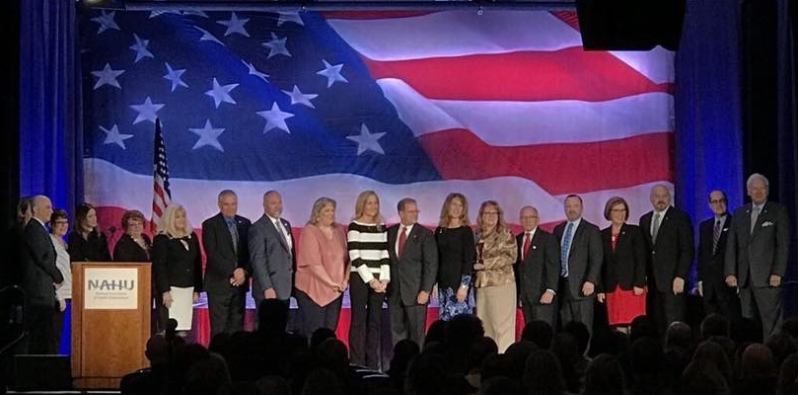
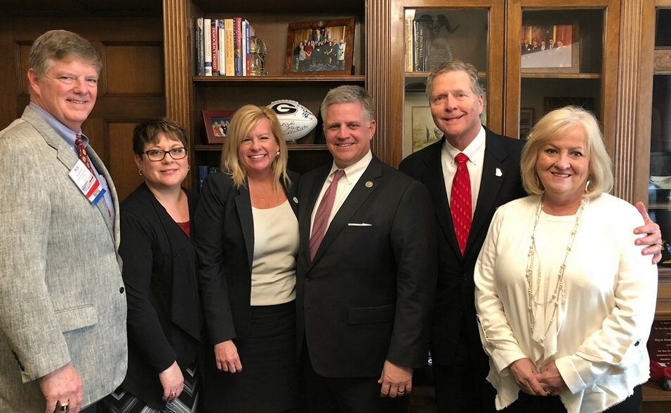

View from the Hill
Town Hall – Nick Moriello, Vice Chair, Leg Council, Janet Trautwein, CEO, Annette Bechtold, Chair, Leg Council
Meeting with Congressman Drew Ferguson (R-GA)
NAHU Board of Trustees – Capitol Conference
Gary Cox – VAHU, Chair of ER Working Group, Leg Council and Annette Bechtold, Chair, Leg Council

Slide 5

Advocacy Agenda
Omnibus tax bill set for March 23
Funds Government through Sept 30
Opportunity to include changes in the tax bill
Focus was items with potential for inclusion in omnibus bill
Market Stabilizers to Reduce Cost and Improve Individual and Employer Market Risk Pool
Taxes and Other Repeals
Medicare

Slide 6
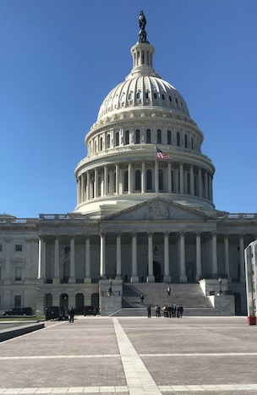
Market Stabilizers
Individual Market
Tax credits outside exchange
Individual & Employer - HSAs
Increase flexibility
After market stabilizers are in place, allow:
Employer-Based Market
Preserve the employer exclusion
Support S1908 and HR3919 to support voluntary employer reporting system to ease the administrative burden on employers
Catastrophic coverage for all
Change grace period to 30 days
Allow states to be eligible for funding new hybrid high-risk pools
Continue CSRs
Contributions to equal OOP
A limited number of office visits prior to deductible
Contributions for working aged

Slide 7

Taxes and Other Repeals
Permanent repeal
  HIT tax - H.R. 246
  Excise “Cadillac” tax – S.58 and H.R.173
Change to Medical Loss Ratio
  Remove agent/broker commission from the calculation
  H.R. 4575 and S.2303
  Improves consumer access to professional independent health agents and brokers

Slide 8

Medicare Changes
Allow COBRA to count as creditable coverage
  Bi-partisan bill introduced 2/27/18
  H.R.5104
Medicare Advantage market rules
  Suspend scope of appointment requirements
Observation and skilled nursing
  Allow observation status to count toward 3-day in-patient requirement for skilled nursing benefits
  H.R.1421 and S.568

Slide 9

ESC Coalition

Slide 10










The Partnership for Employer-Sponsored Coverage (P4ESC) is an advocacy alliance for employers of all sizes and the millions of hard working Americans and their families who rely on employer-sponsored coverage every day. Employer-sponsored coverage is the backbone of our nation’s health care system, insuring the lives of over 178 million Americans. P4ESC is working to ensure that employer-sponsored coverage is strengthened and remains a viable, affordable option for decades to come. www.p4esc.org @P4ESC

Slide 11
Legislative Outlook
Advocate for ACA technical changes/fixes
  Employer IRS reporting reform
  Full-time definition
  HSA/FSA changes
  Health insurance tax relief
  Employer mandate relief
Protect current tax treatment of ESC (cap on employee exclusion)
Protect ERISA (waivers/state flexibility)
Guard against single-payer/Medicare buy-in efforts
Guard against employer automatic enrollment mandate

Slide 12
Regulatory Outlook
Trump Administration 2:1 regulatory relief
October 2017 announcement on association health plans, short-term limited duration plans, health reimbursement arrangements
Treasury/IRS have little authority to address employer mandate penalty relief (4980H) without congressional action
Employer mandate penalty relief does not lessen burden of employer IRS reporting (6055/6056) – two separate Code requirements
HHS Exchange notices; Labor reporting
EEOC wellness rules

Slide 13

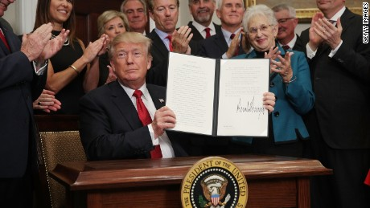
Update on the Executive Order
Update on the Constitutionality of PPACA

Slide 14
Executive Order – October 17, 2017 Departmental Requests
Feasibility of expanding and consideration of proposing regulations or revising guidance
Association Health Plans (AHPs)
Short-term Health Plans
Health Reimbursement Arrangements (HRAs)
Review of ERISAs “employer” definition
Consider ways to promote AHPs for common geography or industry
Propose regulations or revise guidance to expand availability
Due in 60 days –
Consider longer coverage periods and renewability
Due in 60 days
Provide employers with enhanced usability, ability to offer, and allowance to reimburse non-group expenses
Due in 120 days
Proposed rule received 1/4/18
Comments due 3/6/18
Proposed rule received 2/21/18
Comments due 4/23/18

Slide 15
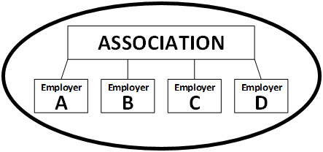
DOL Proposes New Rule on Association Health Plans (AHPs)
Expands existing ERISA and AHP rules in the following areas:
Definition of employer
Bona fide associations
Commonality of interest
Nondiscrimination
Dual treatment of working owners as employers and employees
Comments due: March 6, 2018

Slide 16

AHP – Employer Definition
"employer" includes any person acting directly as an employer, or any person acting indirectly in the interest of an employer in relation to an employee benefit plan
"group health plan” - an employee welfare benefit plan to the extent that the plan provides medical care to employees or their dependents through insurance, reimbursement, or otherwise
"employee welfare benefit plan" is any plan, fund, or program established or maintained by an employer, employee organization, or by both an employer and an employee organization, for the purpose of providing certain listed welfare benefits to participants or their beneficiaries

Slide 17
AHP – Bona Fide Association Definition
The group or association exists for the purpose, in whole or in part, of sponsoring a group health plan that it offers to its employer members;
Each employer member in the group health plan is a person acting directly as an employer of at least one employee who is a participant covered under the plan;
The group or association has a formal organizational structure with a governing body and has by-laws or other similar indications of formality;
The functions and activities of the group or association, including the establishment and maintenance of the group health plan, are controlled by its employer members, that control the group or association and the establishment and maintenance of the plan;
The employer members have a commonality of interest as described in paragraph (c) of this section;
The group or association does not make health coverage through the association available other than to employees and former employees of employer members and family members or other beneficiaries of those employees and former employees;
The group or association and health coverage offered by the group or association complies with the nondiscrimination provisions of paragraph (d) of this section; and
The group or association is not a health insurance issuer described in section 733(b)(2) of ERISA, or owned or controlled by such a health insurance issuer.

Slide 18

AHP - Commonality of Interest Definition
Employers being in the same trade, industry, line of business or profession;
or
Employers having a principal place of business in a region that does not exceed the boundaries of the same State or the same metropolitan area (even if the metropolitan area includes more than one State).

Slide 19

AHP – Nondiscrimination Definition
The group or association must not condition employer membership based on any health factor of an employee or employees or a former employee or former employees of the employer member
The group health plan sponsored by the group or association cannot discriminate based on a health factor, e.g. health status, medical condition, claims experience, receipt of health care, medical history, genetic information, evidence of insurability, or disability (29 CFR 2590.702)
The group health plan sponsored by the group or association must comply with respect to nondiscrimination in premiums or contributions required by any participant or beneficiary for coverage
In applying the nondiscrimination provisions of 2 and 3 above, the group or association may not treat different employer members of the group or association as distinct groups of similarly-situated individuals.

Slide 20

AHP – Working Owner Definition
A working owner is an individual who:
Has an ownership right of any nature in a trade or business, whether incorporated or unincorporated, including partners and other self-employed individuals;
Is earning wages or self-employment income from the trade or business for providing personal services to the trade or business;
Is not eligible to participate in any subsidized group health plan maintained by any other employer of the individual or of the spouse of the individual; and
Either:
  Works at least 30 hours per week or at least 120 hours per month providing personal services to the trade or business, or
  Has earned income from such trade or business that at least equals the working owner's cost of coverage for participation by the working owner and any covered beneficiaries in the group health plan sponsored by the group or association in which the individual is participating

Slide 21
Proposed Rule on Short-term Policies
Published 2/21/18; commentary due 4/23/18
Background:
  1997 – Short-term limited duration insurance (STLDI) defined under HIPAA as health insurance that has a contract expiration date that is less than 12 months, including any renewal period
  6/10/16 – Departments modify the definition of STLDI specifying that these policies cannot provide coverage for 3 months or longer, including any renewal period
Proposed rule
  Modifies definition to be consistent with the HIPAA definition
  Requires specific notification in 14 point font – part 2 only required for policies with start dates prior to January 1, 2019
  Effective date will be 60 days after enactment
This coverage is not required to comply with federal requirements for health insurance, principally those contained in the affordable care act. Be sure to check your policy carefully to make sure you understand what the policy does and doesn’t cover. If this coverage expires or you lose eligibility for this coverage, you might have to wait until an open enrollment period to get other health insurance coverage. Also, this coverage is not “minimum essential coverage”.
[If you don’t have minimum essential coverage for any month in 2018, you may have to make a payment when you file your tax return unless you qualify for an exemption from the requirement that you have health coverage for that month.]

Slide 22

States Sue on Constitutionality of ACA
Complaint seeks declaratory judgments that the:
  Individual mandate exceeds Congress’s enumerated powers;
  ACA violates the Due Process Clause and the Tenth Amendment;
  Agency rules promulgated pursuant to the ACA violate the Administrative Procedure Act
Seeks injunction prohibiting federal officials from implementing or enforcing the ACA
States filing suit:
AL | MO
AR | NE
AZ | ND
FL | SC
GA | SD
IN | TN
KS | TX
LA | UT
ME | WV
MS | WI
Suit questions constitutionality of remaining PPACA provisions without individual mandate
“…forces unconstitutional and irrational regime” on states and citizens
Previously, SCOTUS upheld the individual mandate as a tax but ruled that without the tax penalty it would be an unconstitutional exercise of federal power

Slide 23


ANNETTE BECHTOLD
NAHU, Chair, Legislative Council – GAHU, President
SVP, Regulatory Affairs And Reform Initiatives
OneDigital | Health and Benefits
office: 770-250-3008
mobile: 770-296-7254
fax: 678-905-7308
TREY WISE
AAHU, President
Sales Manager
Admin America
office: 678-578-4639
mobile: 678-525-8844
fax: 770-992-0723

