Slide 1
MIND YOUR OWN BUSINESS!
Jeff Morris
Insperity
Presenting to the Georgia Association of Health Underwriters
This presentation is designed to provide general information on the subjects covered. It is not, however, intended to provide specific legal or tax advice and cannot be used to avoid tax penalties or to promote, market, or recommend any tax plan or arrangement. Please note that [Agent/Agency] and its representatives do not give tax or legal advice. You are encouraged to consult your tax advisor or attorney regarding your specific situation..

Slide 2

AGENDA
About Insperity
Business Owners Daily Risks
Buy-Sell Agreements
What Keeps Them Up At Night?
Let’s Make It Personal
What Are Your Options?

Slide 3
DAILY BUSINESS RISKS
Business owners generally expect and
prepare for these risks
Industry Changes ⁃ Regulations ⁃ Automation
Product or Service Quality Challenges
Competition/ Loss of Customers
Economic Conditions

Slide 4
BUSINESS
CONTINUATION RISKS
Business owners are frequently unprepared to deal with these risks
Death / Disability of a Business Owner
01
Death / Disability or loss of a Key Employee
02
Compliance (Employees, HR & Taxes)
03
Employer Risk (Work Comp, Safety Programs & Claims)
04

Slide 5
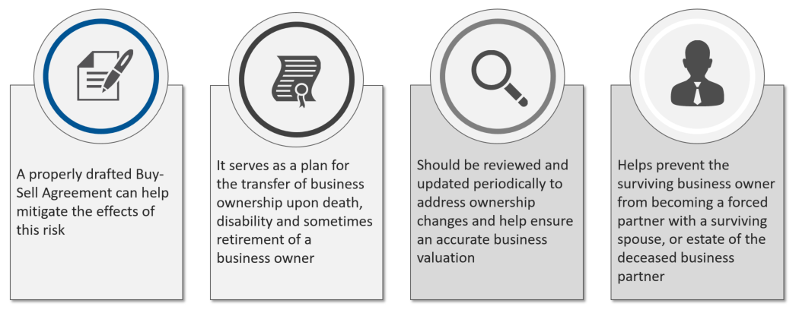
DEATH / DISABILITY OF A BUSINESS OWNER or KEY EMPLOYEE
A BUY-SELL AGREEMENT AND HOW IT CAN HELP…

Slide 6
WHAT KEEPS THEM UP
AT NIGHT…
What business owners are frequently thinking about….
S
Stabilizing and reducing their labor cost -
medical benefits, work comp, admin fees and payroll
T
Transferring related risk - fiduciary compliance
and employer related liability
A
Attracting and retaining top talent – if they are growing
and need to compete for the best employees
R
Reducing admin burden - non revenue
generating functions

Slide 7
5 BIG BENEFITS OF JOININING A PEO
Hand over your everyday HR responsibilities so you can focus on more profitable projects
1.
Access to comprehensive and affordable benefits
Relief from PR and HR admin overload
Ongoing government compliance assistance
Workers compensation coverage and claim resolution
A go-to team of seasoned HR professionals
2.
3.
4.
5.

Slide 8

FROM BUSINESS TO PERSONAL
Business owners work very hard on growing and running their businesses but what about taking care of themselves…?
Why Plan?
Common Tools
Statistics
Options

Slide 9
Why plan?
After paying a lifetime of income taxes, capital gains taxes, sales taxes, living expenses, etc., what's left over becomes part of your estate.
Current estate and gift tax exemptions can be taken advantage of now, and effectively locked in.
As your assets accumulate and appreciate, your estate grows in value.
Planning now can significantly reduce or potentially eliminate exposure to estate taxes in the future.

Slide 10
Common Tools:
Will
Durable Power of Attorney
Medical Directive
Insurance Review (Key Person, Disability and Life)
Investment Portfolio Review
Succession Planning
Tax Planning
Long Term Care

Slide 11
Questions?

Slide 12
Thank You!
Jeff Morris, Business Performance Advisor
INSPERITY
300 Galleria Pkwy. Suite 1630
Atlanta Georgia 30339
Office 678-831-3665 | Cell 404 317-7039
jeff.morris@insperity.com | www.insperity.com
We do not provide tax or legal advice. You are encouraged to consult your tax advisor or attorney.

