Slide 1
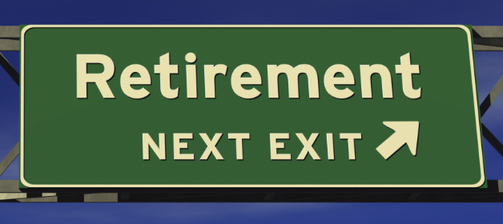
Incorporating Social Security Into The Planning Conversation

Slide 2

Social Security Terms
Full Retirement Age is the age at which you are eligible to receive 100% of your Primary Insurance Amount. It is also the age claimant must be if they want to file strategically.

Slide 3
Social Security Term
The "primary insurance amount" (PIA) is the benefit (before rounding down to next lower whole dollar) a person would receive if he/she elects to begin receiving retirement benefits at his/her normal retirement age.

Slide 4
Social Security Term
Average Indexed Monthly Earnings (AIME)
When we compute an insured worker's benefit, we first adjust or "index" his or her earnings to reflect the change in general wage levels that occurred during the worker's years of employment. Such indexation ensures that a worker's future benefits reflect the general rise in the standard of living that occurred during his or her working lifetime.
Key point: best 35 years of earnings are used to calculate AIME.

Slide 5
Social Security Term
Delayed retirement credits (DRCs) are credits we use to increase the amount of your old-age benefit amount. You may earn a credit of 2/3 of 1% for each month during the period beginning with the month you attain full retirement age and ending with the month you attain age 70. The delayed credit is 8% per year for each year delayed.

Slide 6
Social Security Term
Deeming rule: If you file for benefits prior to full retirement age, you are deemed to have filed for all benefits for which you are eligible. A claimant who is entitled to a reduced retirement benefit and a reduced spouse's benefit must file for both benefits if eligibility for both benefits exists in the first month of entitlement.
Key point: Deeming rule does not apply when claiming survivor benefits

Slide 7
Full Retirement Age, when You are Eligible to Receive 100% of PIA
Year of Birth * | Full Retirement Age
1937 or earlier | 65
1938 | 65 and 2 months
1939 | 65 and 4 months
1940 | 65 and 6 months
1941 | 65 and 8 months
1942 | 65 and 10 months
1943--1954 | 66
1955 | 66 and 2 months
1956 | 66 and 4 months
1957 | 66 and 6 months
1958 | 66 and 8 months
1959 | 66 and 10 months
1960 and later | 67
*If you were born on January 1st of any year you should refer to the previous year. (If you were born on the 1st of the month, we figure your benefit (and your full retirement age) as if your birthday was in the previous month.)

Slide 8

Who is Eligible for Social Security Retirement Benefits
A worker who has accumulated a minimum of 40 work credits (about 10 years work)
Benefit is based on an average of the highest 35 years of earnings in which the worker paid payroll taxes.
The spouse of an eligible worker
An ex-spouse who was married at least 10 years to an eligible worker

Slide 9
PIA Bend Points
  For an individual who first becomes eligible for old-age insurance benefits or disability insurance benefits in 2018, or who dies in 2018 before becoming eligible for benefits, his/her PIA will be the sum of:
  (a) 90 percent of the first $895 of his/her average indexed monthly earnings, plus(b) 32 percent of his/her average indexed monthly earnings over $895 and through $5,397, plus(c) 15 percent of his/her average indexed monthly earnings over $5,397.

Slide 10

Earliest Filing Age
The earliest age at which you can begin receiving your Social Security retirement benefits is 62*. You can apply for your benefits 3 months before you turn 62 if you want your payments to start at that age.
The reduction is permanent
*Survivor benefits can be filed as early as age 60.

Slide 11
Filing Age
*The percentages for the spousal benefit are based on the primary workers Primary Insurance Amount (benefit at full retirement age)

Slide 12
Bipartisan budget act of 2015
The new rules dramatically change Social Security claiming options and effectively divide each individual into one of three groups:
People born on or before May 1, 1950 will be the least affected, although if they plan to suspend their retirement benefit and still allow others to collect auxiliary benefits based on their record (i.e., spousal and child benefits) during suspension, they must request benefit suspension no later than April 29, 2016.
People born between May 2, 1950 and January 1, 1954 will see mixed effects of the new rules on their optimal benefits filing strategy.
People born on or after January 2, 1954 will be the most affected in terms of the effects of filing and suspending as well as not being able to file a restricted application for either just a spousal benefit or just a retirement benefit even after their full retirement age. They will not receive auxiliary benefits during suspension.

Slide 13

SPOUSAL BENEFIT
Even if you have never worked under Social Security, you may be able to get spouse’s retirement benefits if you are at least 62 years of age and your spouse is receiving retirement or disability benefits.
BENEFIT AMOUNT IS 50% OF COVERED WORKERS PIA.
COVERED WORKER MUST HAVE FILED FOR BENEFITS BEFORE SPOUSE CAN APPLY.
MUST BE MARRIED 12 MONTHS TO BE ELIGIBLE FOR SPOUSAL BENEFIT.

Slide 14

Ex-Spouse Benefit
Married for 10 or more years, divorced for less than 2 years.
NH has to have filed for benefits in order for ex-spouse benefit to be available.
Ex-spouse benefit does not count toward family maximum

Slide 15

Independently Entitled Ex spouse
If you are divorced for 2 or more years, but your marriage lasted 10 years or longer, you can receive benefits on your ex-spouse's record (even if he or she has remarried) if:
You are unmarried;
You are age 62 or older;
Your ex-spouse is entitled to Social Security retirement or disability benefits and
The benefit you are entitled to receive based on your own work is less than the benefit you would receive based on your ex-spouse's work
*Key point: This benefit is available provided you have not remarried.

Slide 16
Survivor Benefit
Your widow or widower can receive:
  reduced benefits as early as age 60 or full benefits at full retirement age or older.
If your widow or widower remarries after they reach age 60 (age 50 if disabled), the remarriage will not affect their eligibility for survivors benefits.
MUST BE MARRIED 9 MONTHS TO BE ELIGIBLE FOR SURVIVOR BENEFIT

Slide 17
Survivor Full Retirement Age
Year of Birth ^{1.} | Full (survivors) Retirement Age ^{2.} | At age 62 ^{3.} a $1000 survivors benefit would be reduced to | Months between age 60 and full retirement age | Monthly % reduction ^{4.}
1939 or earlier | 65 | $829 | 60 | .475
1940 | 65 and 2 months | $825 | 62 | .460
1941 | 65 and 4 months | $822 | 64 | .445
1942 | 65 and 6 months | $819 | 66 | .432
1943 | 65 and 8 months | $816 | 68 | .419
1944 | 65 and 10 months | $813 | 70 | .407
1945 - 1956 | 66 | $810 | 72 | .396
1957 | 66 and 2 months | $807 | 74 | .385
1958 | 66 and 4 months | $805 | 76 | .375
1959 | 66 and 6 months | $803 | 78 | .365
1960 | 66 and 8 months | $801 | 80 | .356
1961 | 66 and 10 months | $798 | 82 | .348
1962 and later | 67 | $796 | 84 | .339
Monthly reduction percentages are approximate due to rounding. The maximum benefit is limited to what the worker would receive if he or she were still alive. Survivors benefits that start at age 60 are always reduced by 28.50%.

Slide 18

Filing early for Survivor Benefit
The “Deeming Rule” does not apply to a spouse filing for benefits before full retirement age!
A claimant could file for survivor benefit at age 60 and switch to benefit based on his or her own work history at a later date if that benefit is larger.
Or
Claimant could file for reduce benefit at age 62 based on their own work history and switch to survivor benefit at full retirement age.

Slide 19
“Restricted Application” for spousal benefits
The Bipartisan Budget Act of 2015 limits eligibility for this strategy to those who are born January 1, 1954 or prior.
By claiming a restricted application for the spousal benefit upon reaching full retirement age, you can delay receiving benefits based on your own work history and later switch to the potentially higher benefit amount.
If filing before full retirement age the “deeming rule” applies and restricted application is not available.

Slide 20
Restricted application case study
Jim & Jane both age 66
Jim: Eligible for $2,000 monthly benefit at age 66 or $2,640 at age 70
Jane: Eligible for $1,600 monthly benefit at age 66
If both claim benefits at age 66, they could receive a total of $1,036,800 over the next 24 years.
If Jane claims her worker benefit at age 66, Jim could claim a restricted application for a spousal benefit of $800 at age 66 and delay his own worker benefit.
Then at age 70, Jim could switch to his own maximum monthly worker benefit of $2,640
This strategy could yield a total of $1,132,800 over 24 years.

Slide 21
Windfall Elimination Provision and Government Pension Offset
WEP: The Windfall Elimination Provision may affect how we calculate your retirement or disability benefit. If you work for an employer who does not withhold Social Security taxes from your salary, such as a government agency or an employer in another country, any pension you get from that work may reduce your Social Security benefits.
GPO: If you receive a pension from a federal, state, or local government based on work for which you didn’t pay Social Security taxes, we may reduce your Social Security spouses or widows or widowers benefits.

Slide 22
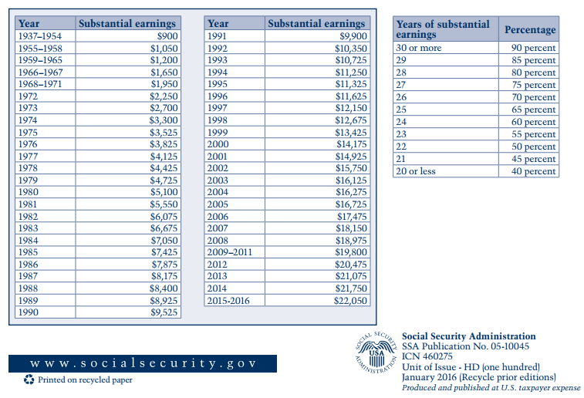
WEP Substantial Earnings

Slide 23
WEP Example
Fred retired from a job that had a social security exempt pension. He will draw pension of $3,000 per month. Fred worked and paid into social security for 10 years with another employer.
Fred’s AIME for the 10 yrs. is $800.
Normal social security benefits would be $800x90%=$720
Since Fred falls under WEP his social security benefit will be $320 per month $800x40%=$320
WEP does not apply until non-covered pension is received

Slide 24
Government Pension Offset (GPO)
If you receive a pension from a government job in which you did not pay Social Security taxes, some or all of your Social Security spouse's, widow's or widower's benefit may be offset due to receipt of that pension. This offset is referred to as the Government Pension Offset, or GPO.
The GPO will reduce the amount of your Social Security spouse's, widow's or widower's benefits by two-thirds of the amount of your government pension.

Slide 25
GPO Example
Jane is 66 and draws $3,000 per month in non covered pension. Her husband Jim dies: he was drawing $2,500 social security benefit based on his work history.
Normally Jane would be eligible as survivor to receive the $2,500 monthly benefit however due to GPO she will receive $500 survivor benefit.
pension x calculation=GPO SS survivor - GPO = survivor benefit
benefit
$3,000x2/3=$2000, $2,500-$2,000=$500

Slide 26

Earnings Test
If you are under full retirement age for the entire year, we deduct $1 from your benefit payments for every $2 you earn above the annual limit. For 2018, that limit is $17,040.
In the year you reach full retirement age, we deduct $1 in benefits for every $3 you earn above a different limit. In 2018, the limit on your earnings is $45,360 but we only count earnings before the month you reach your full retirement age

Slide 27

Special Earnings Test Rule
Note: If your earnings will be over the limit for the year but you will be retired for part of the year, we have a special rule that applies to earnings for one year. The special rule lets us pay a full Social Security check for any whole month we consider you retired, regardless of your yearly earnings.

Slide 28
Special Earning Test
Filing early annual limit $17,040
Monthly test limit $1,420
If you are not going to make more than $1,420 per month after claiming Social Security benefits you will receive benefits without reduction regardless of how much you made before claiming SS benefits
Filing early annual limit in the year you reach full retirement age $45,360
Monthly test Limit $3,780
Unlimited income can be earned starting the month you reach full retirement age.

Slide 29

Benefit Reductions who’s affected
When earnings test is applied to NH benefit, NH benefit and all supplemental benefits (spousal, dependent) are impacted.
When earnings test applies to supplemental benefit (spousal benefit) only the supplement benefit is affected.

Slide 30
Will Your Social Security
Benefits Be Taxed?
Taxable Portion of Benefits | Combined Income
 | Single Filer | Married Joint Filer
50% | $25,000 to $34,000 | $32,000 to $44,000
85% | Over $34,000 | Over $44,000
“Combined income” formula used by the IRS:
Adjusted gross income
+ Tax-exempt interest
+ 50% of Social Security benefits

Slide 31
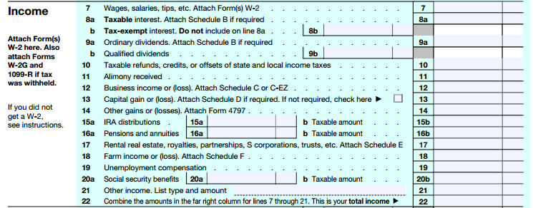
Taxable Social Security
Total Social Security Benefit
Taxable Social Security

Slide 32
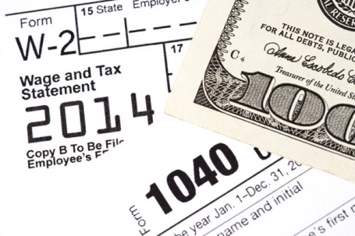
What Makes up Provisional Income
Provisional income = gross income + tax-free interest + 50% of Social Security benefits + any tax-free fringe benefits and exclusions - adjustments to income

Slide 33

What Is Not considered Provisional Income
Roth IRA distributions
Properly structured Life Insurance Distributions

Slide 34
Will My Social Security Be Taxable
Income sources Couple 1 Couple 2
(TIRA) (ROTH)
Interest CD’s $2,000 $2,000
Stock Dividends $12,000 $12,000
Tax free Bonds $6,000 $6,000
IRA distribution $25,000 $25,000*
Social Sec. benefit $22,000** $22,000**
Total income $67,000 $67,000
Provisional income $56,000 $31,000
Taxable Social Sec. Up to 85% “0”
This is a hypothetical example results will vary
*Roth IRA distribution is invisible when calculating provisional income.
** 50% of Social Security is used in calculating Provisional income.

Slide 35
Common Confusion
Provisional Income that determines taxation of social security benefit
Earnings Test for early retiree
50% of social security
Pension income
Taxable interest
Tax exempt interest
Qualified plan distributions (not Roth IRA distributions)
W-2 income
Profit from self employment
Earned income (W-2)
Profit from self employment

