Slide 1

Government Affairs:
Lobbying / Ethics

Slide 2
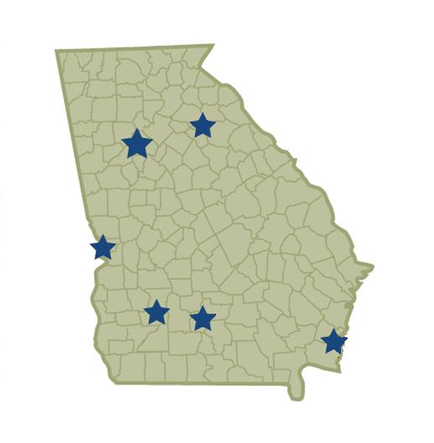
Statewide Strength
Atlanta
Athens
Six Offices in Georgia
100 + lawyers
Headquartered in Atlanta
Columbus
Tifton
Brunswick
Albany

Slide 3
Statewide Strength
Atlanta: Rep. Sam Teasley, Rep. Renitta Shannon, Rep. Burt Reeves, Rep. Brad Raffensperger; all members of the Insurance Committee.
Columbus: Rep. Richard Smith, Insurance Committee Chairman; Carolyn Hugley, Minority Whip and Insurance Committee; Senator Ed Harbison, Senate Insurance Committee; Sen. Josh McKoon, Senate Insurance Committee.
Brunswick: Rep. Jeff Jones, House Insurance Committee; Mickey Stephens, House Insurance Committee.
Athens
Atlanta
Columbus
Tifton
Albany
Brunswick

Slide 4
Government Affairs Team
Brad Carver
Bob Middleton
Joel McKie
Susan Griffiths
Russell Britt
Former Senator Michael Meyer von Bremen
David Ware
Wayne Satterfield
Sheila Kazemian

Slide 5
Strategies for Success
Statewide Approach
Bipartisan Approach
Leverage Key Relationships
Local Government Attorneys (County, City, School Board)
Subject Matter Experts in Insurance Law and Policy

Slide 6
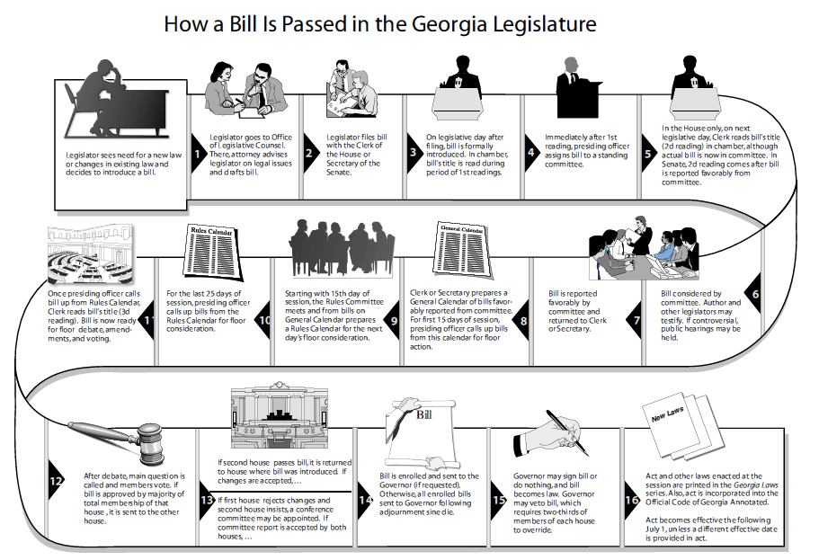

Slide 7
High Profile Legislation in 2018 Session
Adoption Bill (House / Senate Battle)
Rural Economic Development Legislation including Rural Broadband
New Cities: City of Vista Grove & City of Greenhaven (DeKalb County)
Amazon
Governor’s Business Court Proposal
Budget
Upcoming Election

Slide 8
2018 Legislative Issues Most Affecting NAIFA
Premium Guarantees for Insurance Agents
House Bill 64
  Rep. Shaw Blackmon, 146th
  Department of Insurance to specify the commission percentage provided to insurance agents.
  Carriers that issue a health benefit plan shall pay a commission to insurance agents.
  Anti-Discrimination language.
  Status: Passed through the House last session and was recommitted in 2018 in the Senate. Senate Favorably Reported this Bill by Substitute last week.
Notes:
This bill relates to general insurance provisions to provide compensation of health insurance agents in certain situations. HB 64 would require carries that issue a health benefit plan in this state through an agency pay a commission to insurance agents. Commission payment must not be structured in a way that would directly or indirectly discriminate the amount of compensation paid to an agent for the sale of a group or individual health benefit plan.

Slide 9
2018 Legislative Issues Most Affecting NAIFA
Premium Guarantees for Insurance Agents
House Bill 63
  Rep. Shaw Blackmon, 146th
  Department of Insurance to specify the commission percentage provided to insurance agents.
  Carriers that issue a health benefit plan shall pay a commission to insurance agents.
  Anti-Discrimination language.
  Status: Did not cross over. Backup bill. Our “insurance.”

Slide 10
2018 Legislative Issues Most Affecting
NAIFA
House Bill 734
  Rep. Richard Smith 134th
  Modernization of the code
  Updated language for the Commission on the Georgia Health Insurance Risk Pool, repealed Article 2 of Chapter 29A
  Repealed conflicting law
  Status: this bill has gone through the House and is currently being read in the Senate Insurance Committee

Slide 11
2018 Legislative Issues Most Affecting
NAIFA
House Bill 678
  Rep. Richard Smith 134th
  Consumer protections in the health insurance market
  Disclosure requirements of providers, hospitals, and insurers
  Arbitration requirements
  Bill reimbursements
  Status: This bill has gone through the House has been referred to the Senate Insurance Committee

Slide 12
2018 Legislative Issues Most Affecting NAIFA
House Bill 818
  Rep. Lee Hawkins 27th
  Reimbursement method selected by Health Care Provider
  Enforcement power for violation
  Status: This bill has gone through the House has been referred to the Senate Insurance Committee

Slide 13
2018 Legislative Issues Affecting NAIFA
Senate Bill 8
  Sen. Unterman, 45th
  Surprise Billing and Consumer Protection Act
  Disclosure requirements for providers, hospitals, and insurers for the billing and reimbursement of out-of-network services.
  Dispute resolution provisions
  To remove the patient from the conflict between providers and insurance companies
  For out-of-network disputes – medical providers to be paid at a rate that is 80% of the benchmark charges for the procedure in the area code where services rendered.
  Based on Fair Health database charges. Does not include charges to Medicare and Medicaid.
  Status: House Insurance Favorably Reported this bill by Substitute on Monday

Slide 14
2018 Legislative Issues Most Affecting NAIFA
House Bill 214
  Rep. Golick, 40th
  Provides punishment for the unlawful manufacture, sale, or distribution of a proof of insurance document and the issuing of fake or counterfeit insurance id cards.
  Status: This bill passed in the House, and passed out of Committee by Substitute in the Senate. However, this bill never made it out of Senate Rules last session. The Senate Recommitted this bill in January and it has not moved since. However, because it passed though both chambers last session this bill is still alive.

Slide 15
2018 Legislative Issues Most Affecting NAIFA
Senate Bill 248
  Sen. Harbin, 16th
  Relates to life insurance and requirement to review the National Association of Insurance Commissioners life insurance policy locator.
  Status: This bill did not crossover last session but it was read in the Senate Insurance and Labor Committee in February 2018. It passed the Senate and is currently being read in the House Insurance Committee.

Slide 16
2018 Legislative Issues Most Affecting NAIFA
House Resolution 993
  Rep. Chuck Efstration 104th
  Business Court Amendment
  Gov. Deal’s Pilot Program
  Status: The Resolution passed the House and is being considered by the Senate Judiciary Committee.

Slide 17
QUESTIONS?

